Slide 1
Overview of CBV SOPs (AS, CHW)

Slide 2
Table of Contents
1 : Post Appointment Matters
1.1: Duty Station Transfers & Reshuffling
2. Conduct of Employees
2.1 Exclusive Service & Conflict of Interest
2.2 Media & Political Policy
2.3 General Conduct
2.4 False Representation
2.5 Public Holiday
2.6Kinship & Conflict of Interest Policy
3. Key Features of Separation
3.1 Resignation
3.2 Termination
3.3 Retirement

Slide 3
Table of Contents
4. Disciplinary Matters
4.1 Disciplinary Matters
4.2 Performance Evaluation
5. Leave and Attendance Policy
6. Payment allowance
4.1 Group Life Insurance
4.2 DSA and Accommodations
4.3 Payment Guidelines
7. Complaint Reporting Source

Slide 4
Post Appointment Matters
Duty Station Transfers & Reshuffling
Requests for transfers may come from staff, field teams or WHO or its program partners due to shifts in program needs.
A consent form is required when staff is transferred from one UC to another UC unless it is due to disciplinary action.
Notes:
All staff has a specific area/duty station assigned, and only CTC holds the authority to modify their duty station.
We have two type of transfers/ shuffling: Permanent and Second one is temporary.
For AS and CHW Transfers: approval from the respective WHO PO is required for transfers within the UC. For transfers beyond UC boundaries, approval from WHO FO is required.
For UC and above position: Approval from WHO FO is required for all transfers.

Slide 5
Conduct of Employees
Exclusive Service & Conflict of Interest:
Staff devote their whole time and energy to the polio eradication initiative and completion of activities as per their TOR and work plan. No worker can be engaged in any other profession, trade, commerce or business activity with remuneration or otherwise on his own account or enter in the service or be employed by any other person or firm or assist in any business owned by his spouse or parents (whether on full or part time basis).
Notes:
Working days and policies and working hours are followed as per district/government policy. However, the nature of work requires working till late evening or on holidays/weekends.

Slide 6
Conduct of Employees
Media & Political Policy:
Staff are not allowed to communicate with the media (print and electronic) vis-a-vis queries, interviews, etc. in any manner whatsoever. Likewise, involvement in political activity, platform or affiliation with any political party is considered misconduct which can lead to termination of the services.
a. The policy doesn’t put bars on anybody with respect to attending media for social, entertainment related matters, casting votes etc.
b. Taking part in rallies and processions, actively pursuing membership of any political party, contesting election as a candidate, influencing, or mobilizing anybody for favoring certain political parties etc. are strictly not allowed and may lead to immediate termination
Notes:
Working days and policies and working hours are followed as per district/government policy. However, the nature of work requires working till late evening or on holidays/weekends.

Slide 7
Conduct of Employees
General Conduct
Staff general behavior should be polite, amicable, helpful, and
conducive to professional conduct of the affairs of the company
False Representation
Staff are also not authorized to present themselves as WHO staff or
identify WHO as their employer at any forum. Similarly, they cannot
use WHO name or logo on their visiting cards, CV, LinkedIn
/Facebook profile or any other social media.
Notes:
All staff has a specific area/duty station assigned, and only CTC holds the authority to modify their duty station.
We have two type of transfers/ shuffling: Permanent and Second one is temporary.
For AS and CHW Transfers: approval from the respective WHO PO is required for transfers within the UC. For transfers beyond UC boundaries, approval from WHO FO is required.
For UC and above position: Approval from WHO FO is required for all transfers.

Slide 8
Conduct of Employees
Public Holiday
The staff is entitled to public holidays as per the official list issued
every year by the Government of Pakistan, or by the
Provincial/district Government. No leave application form needs to
be submitted for availing
Notes:
All staff has a specific area/duty station assigned, and only CTC holds the authority to modify their duty station.
We have two type of transfers/ shuffling: Permanent and Second one is temporary.
For AS and CHW Transfers: approval from the respective WHO PO is required for transfers within the UC. For transfers beyond UC boundaries, approval from WHO FO is required.
For UC and above position: Approval from WHO FO is required for all transfers.

Slide 9
Conduct of Employees
Kinship & Conflict of Interest Policy
Staff cannot be hired for a position where they are supervised by any blood relative (brothers, sisters, children, parents, uncle, aunt, nephew, niece, cousin, spouse etc.).
Hiring of blood relatives of WHO and CTC staff are to be approved in advance by WHO Federal office. Generally, such approvals are not granted except if there is any genuine compelling reason to do so or a valid ground.
Each worker is required to fill and sign a kinship and conflict of
interest form.
Notes:
We have a proper kinship policy in which it is clearly defined that no can work under the direct supervision of their blood relative to avoid any conflict of interest and biasness, discrimination, favoritism.
In case of wrong information provided then the staff contract will be terminated on immediate basis

Slide 10
Key Features of Separation
Key Features of Separation
Resignation: Staff may submit a resignation with appropriate 7 days of prior notice.
Exit Interview
CC on violation of Resignation Policy
Experience letter
Retirement: Staff is subject to compulsory retirement on reaching the age of 60 for Male and 55 for female.
Notes:
AS and CHW: 7-day prior notice period is required with no salary deduction.
UC and above: required to serve 15-day notice period with no salary deduction.
In both cases, staffs are paid for actual field days worked. CTC conclude the contract of staff not adhering to notice periods.
If CTC wants to conclude anyone's contract during his active contract period then we have to give them a notice of 15 days
CTC HR issues termination letters based on instructions from WHO Federal Office
Resignation cannot take effect, while disciplinary proceedings are ongoing.
CTC focal person conducts exit interview over phone.
If a staff member doesn’t submit a written resignation, the supervisor can declare it on their behalf for CTC‟s acceptance.
If the exit interview shows that the supervisor false information with malicious intent, CTC may investigate the matter.

Slide 11
Disciplinary Matters
Disciplinary Matters Policy
CTC reserves the right to take disciplinary action against any personnel, if found guilty of misconduct as per the categorization defined in the Disciplinary Action framework procedure and guidelines.
If the case is related to Gross Misconduct then CTC will forward the case to IOS and notify the AC and WHO PO
Once the case is with IOS, there is an expected timeline of 120 days for resolution.
During the investigation, CTC maintains active communication and provides any necessary information requested by IOS to facilitate the process.

Slide 12
Disciplinary Matters
Disciplinary Matters Policy
If the complaint pertains to performance-related issues or absenteeism, CTC will initiate disciplinary action against the staff involved.
CTC aims to resolve cases related to complaints within a relatively short timeframe of 7 to 10 working days.

Slide 13
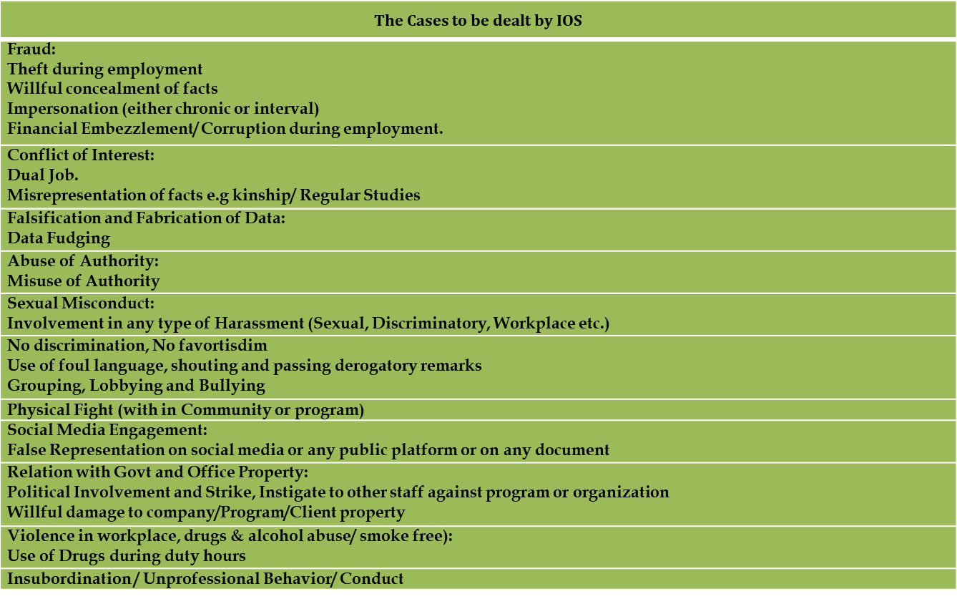
Disciplinary Matters

Slide 14
Performance Evaluation
Performance Appraisal policy
Staff Performance evaluation is executed bi-annually (December & June). Additionally, staff members marked as “need improvement” or unsatisfactory are re-evaluated after three months (March and September). In case of no improvement, disciplinary action can be taken accordingly.
Performance Status | Percent Marks | Action
Satisfactory | 70% and above
Need Improvement | Equal and above 50% to less than 70% | Disciplinary actions will be taken on case-to-case basis in each appraisal process.
Unsatisfactory | Below 50%
Notes:
Performance Status
Percent Marks
Possible Actions
Remarks
Satisfactory
70% and
above
Contract extension
Need Improvement
Equal and above 50% to
less than 70%
1st Time: Counselling session with need improvement letter. The staff will be re-evaluated after three months.
2nd Time: Warning letter and will be re-evaluated after 3 months.
3rd Time: Final Warning letter and will be re-evaluated after 3 months.
4th Time: Termination
Disciplinary actions will be taken on case-to-case basis in each appraisal process.
Unsatisfactory
Below 50%
1st Time: Warning letter and
will be re-evaluated after 3
months.
2nd Time: Final Warning letter
and will be re-evaluated after 3
months.
3rd Time: Termination

Slide 15
Leave and Attendance Policy
Leave Policy:
Each worker is entitled to five working days leave during their three-months of contract, and a total 20 working days of leave per calendar year.
20 days annual leave is to cover sickness, emergency, domestic issues, wedding, mourning etc. Such leaves must be duly authorized by the supervisor and notified to CTC in advance.
50% of unused leave can be carried forward to the next calendar year.
No leave encashment is admissible under any circumstances.
Staff required to work on a Sunday may get compensatory leave
during the following week duly authorized by the supervisor

Slide 16
Leave and Attendance Policy
Exceptional Leave :
Female staff are entitled to 65 days maternity leave, comprising 20 days unpaid pre-natal leave and 45 days paid post-natal leave.
In case of injuries while at work : 2 weeks paid leave
In case of injuries while not performing in the field: 2 weeks unpaid leave
Notes:
If any staff faces injury or illness due while performing field activities during his/her daily job, s/he is entitled to two weeks paid medical leave in case of hospitalization.
In case of injuries while not performing in the field, they can take up to two weeks off without pay if they are to stay in the hospital or as per doctor’s recommendation for bed rest.

Slide 17
Leave and Attendance Policy
Attendance
All AS and CHW staff are required to mark attendance in the register every day and attend the office or field (as applicable) punctually. Working days and policies and working hours are followed as per district/government policy. However, the nature of work requires working till late evening or on holidays/weekends.
Notes:
If any staff faces injury or illness due while performing field activities during his/her daily job, s/he is entitled to two weeks paid medical leave in case of hospitalization.
In case of injuries while not performing in the field, they can take up to two weeks off without pay if they are to stay in the hospital or as per doctor’s recommendation for bed rest.

Slide 18
Payment Allowance
Group Life Insurance
All employees are entitled to Personal accidental medical expenses, accidental death, the risk of death due to terrorism, and death if murdered after kidnapping insurance is covered.
Accidental Insurance: Rs. 500,000.
Death & Disability Insurance: Rs. 500,000.
Accidental Death coverage: Rs.1,000,000, which is double the sum covered.
EOBI Contribution
A contribution equal to 5% of minimum wages has to be paid by the Employers and 1% of minimum wages by the employees of said Organizations
Notes:
EOBI (Employees Old-Age Benefits Institution) contribution which is to be made for all staff on the payroll subject to registration with EOBI

Slide 19
Payment Allowance
DSA and Accommodations
 | Positions | DSA & Accommodation for Specified Major Cities (PKR) | DSA & Accommodation for Other Areas (PKR)
UC Level and below | Where Night Stay is Involved | 6,000 | 6,000
 | Where Night Stay is not Involved | 2,000 | 2,000
Notes:
EOBI (Employees Old-Age Benefits Institution) contribution which is to be made for all staff on the payroll subject to registration with EOBI

Slide 20
Payment Allowance
Payment Guidelines
Salaries are paid after deduction of withholding tax or any other applicable deduction (absence from duty, any statutory deduction) by the 5th of each month, subject to receipt of funds from WHO.
Salaries are processed through the banking channel only. Cash transactions are not admissible under any circumstances.
CTC may facilitate newly hired personnel for the opening of bank accounts by giving them reference letters. They have to open their account within a month.
Notes:
AS and CHW: 7-day prior notice period is required with no salary deduction.
UC and above: required to serve 15-day notice period with no salary deduction.
In both cases, staffs are paid for actual field days worked. CTC conclude the contract of staff not adhering to notice periods.
If CTC wants to conclude anyone's contract during his active contract period then we have to give them a notice of 15 days
CTC HR issues termination letters based on instructions from WHO Federal Office
Resignation cannot take effect, while disciplinary proceedings are ongoing.
CTC focal person conducts exit interview over phone.
If a staff member doesn’t submit a written resignation, the supervisor can declare it on their behalf for CTC‟s acceptance.
If the exit interview shows that the supervisor false information with malicious intent, CTC may investigate the matter.

Slide 21
Complaint Reporting Source
Contact point for | Email ID | Phone Number
For complaint | Complaint.ctc@chipconsulting.org | 03461313684
For PRSEAH | PRSEAH@chipconsulting.org | 03427656693

Slide 22
Thank You

