Slide 1
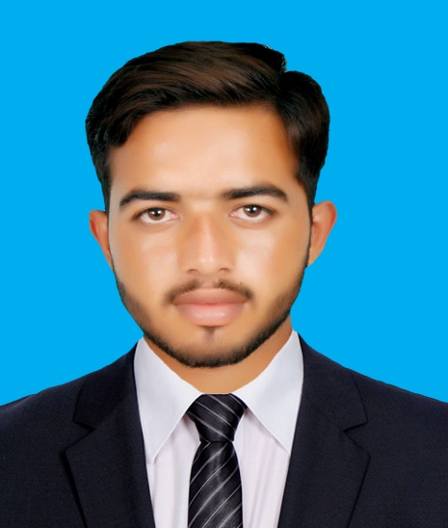
Contact Info:
+92 3065219966
iambaqir995@gmail.com
P.O Box Khaas Dhurnal Tehsil Fateh Jang, District Attock.
Objective:
A highly organized and hard working individual looking for a responsible position to gain practical experience and where I can polish up my all capabilities in the best possible manner & to utilize my education for the well-being of organization.
BAQIR ALI
Personal Information:
Father Name
Muhammad Safdar
CNIC
37102-5535665-9
Software Skills
Passport No
ZH1826651
MS Office
Star UML
Date of Birth
August 24, 1999
Religion
Islam
Nationality
Pakistani
Strengths
Academic Qualifications:
Excellent Communication Skill
Highly responsible and Punctual
Leadership Skills.
Ambitious and Energetic
Quick learner of various software
Qualification | Passing Year |  | Institution
M.Cs. (Computer Science) | 2021 |  | Comsats University Islamabad (Attock Campus)
B.Sc. (Computer, Economics) | 2019 |  | University of Punjab, Lahore
F.Sc. (Pre-Engineering) | 2017 |  | Rawalpindi Board
Matric (Science) | 2015 |  | Rawalpindi Board
Hobbies
Playing Cricket
Gardening
Watching informative videos
Languages
Experience:
English
Urdu
Punjabi
Fresh Graduate
Certificates:
NEBOSH IGC, Rewaq Ousha Educational Institute-1644 .
Major Subjects:
Software Engineering
Operating System Concepts
Computer Communication & Networks
Database System

