Slide 1
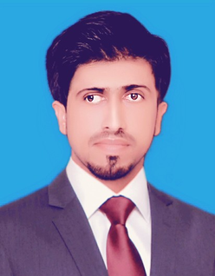
ZUHAIB HASSAN
BS Statistics
Seeking a position in a reputed company as an Administrative person where I can utilize my knowledge and study to serve the company towards progress according to its aims and objectives.
Contact
Experience
Phone
Invigilation Officer
+923133616436
IBA SUKKUR SINDH EDUCATION FOUNDATION
Email
28-Feb-2021 – 23 Mar 2024
Shaikhzuhaib396@gmail.com
The invigilation of school and public examinations. The proper conduct of examination sessions in the presence of the candidates, maintaining security of the assessment process. Being vigilant and supervising candidates at all times to prevent cheating and distractions.
Address
SARHARI TOWN WARD # 6 SHAIKH MUHLA NEAR NAWABSHAH ROAD
Education
Assistant Officer
MESKAY & FEMTEE TRADING COMPANY (PVT) LTD[M1]
B.Ed
10 Jan, 2019 – 30 Nov, 2020
ALAMA IQBAL OPEN UNIVERSITY
  Overseeing clerical tasks, such as sorting and sending mail.
  Keeping an inventory of office supplies and ordering new materials as needed.
  Maintaining files.
  Welcoming visitors to your office.
  Answering phone calls.
  Taking and delivering messages.
  Ensuring the office runs smoothly.
2019 - 2021
BS STATISTICS
University of Sindh, Jamshoro
2013 - 2016
B.COM
Sales Executive Officer
University of Sindh, Jamshoro
SILK BANK Credit Card
2012 - 2013
7 July, 2017 – 28 Feb, 2018
Expertise
  Meeting with clients virtually or during sales visits.
  Demonstrating and presenting products.
  Establishing new business.
  Maintaining accurate records.
  Attending trade exhibitions, conferences and meetings.
  Reviewing sales performance.
Business communication skills
Leadership skills
Team work and collaboration
UN FOOD ORGANIZATION
Time management
  Monitoring of food supply.
  Livelihoods and food security in the context of shock.
  Food security and livelihood assessment project
  Maintaining accurate records
Interpersonal skills
Problem solving and critical thinking
Reference
Language
Reference will be furnished on demand.
English
Urdu
Sindhi

